Slide 1
A Unified View of
Frequency Estimation and their Attacks on
Local Differential Privacy
Al Mehdi Saadat Chowdhury, Dhaval Pankaj Tanna, Deepak Vellanki, Chirag Manjeshwar
School of Computing and Augmented Intelligence
Arizona State University

Slide 2
Outline
Introduction:
Differential Privacy
Local Differential Privacy
Pure LDP Framework
Attack Problem
Frequency Estimation Techniques:
RAPPOR
K Randomized Response (kRR)
Optimized Unary Encoding (OUE)
Optimized Local Hashing (OLH)
Attacks:
General Attack Formulation
Attacking kRR
Attacking OUE
Attacking OLH
Evaluation:
Comparison between Estimators
Gain from Attacks
Impacts of Parameters on Attacks
Conclusion:

Slide 3
Introductory Concepts

Slide 4
Differential Privacy
Dataset,
Features
Labels
Subset of Labels
[
]
[
]
(
)
(
)
M
S
M
S
Notes:
Epsilon = Privacy Budget Delta = Probability of failure / Slack Parameter

Slide 5
Local Differential Privacy
[
]
[
]
(
)
(
)
y
M
y
M

Slide 6
Protocols for Local Differential Privacy
Encode
Perturb
Aggregate
Rice
Bean
Soda
1 | 1 | 0 | 1 | 0 | 0
1 | 0 | 0 | 1 | 1 | 0
1 | 0 | 1 | 1 | 0 | 1
0 | 0 | 0 | 1 | 1 | 0
Rice | Bean | Eggs | Soda | Oreo | Taco
1 | 1 | 0 | 1 | 0 | 0
1 | 0 | 0 | 1 | 1 | 0
2 | 0 | 1 | 3 | 2 | 1
Frequency Estimation Problem

Slide 7
Pure Differential Privacy
A unified framework --- Can be used to define all frequency protocols.
Defined based on two fixed probabilities and
Based on this framework, we will describe 4 protocols – RAPPOR, kRR, OUE, OLH.

Slide 8
Attacking Estimators – Problem Formulation
Assume:
Inject:
To increase frequency of items:
Goal:

Slide 9
Foundational Work

Slide 10
Google’s RAPPOR
Encode
Perturb
Aggregate
0 | 1 | 0 | 0 | 0 | 0
Using Linear Regression
Using LASSO Regression
0 | 1 | 0 | 0 | 1 | 0
0 | 1 | 0 | 0 | 0 | 0

Slide 11
Limitations of RAPPOR
Use of Bloom filter reduced communication cost
However,
  Accuracy decreased significantly
  Computation cost of the aggregation step increased significantly

Slide 12
SOTA Frequency Estimators

Slide 13
K Randomized Response
Encode
Perturb
Aggregate
A | B | C | D | E | F
A | B | C | D | E | F
A | D | C | C | F | E
For kRR,
A | B | C | D | E | F

Slide 14
Optimal Unary Encoding
Encode
Perturb
Aggregate
Item
0 | 0 | 1 | 0 | 0 | 0
0 | 0 | 1 | 0 | 1 | 0
For OUE,
0 | 0 | 1 | 0 | 0 | 0

Slide 15
Optimal Local Hashing
Encode
Perturb
Aggregate
0 | 0 | 1 | 0 | 0 | 0
0 | 0 | 0 | 0 | 0 | 0
For OLH,
0 | 0 | 1 | 0 | 0 | 0

Slide 16
Maximum Gain Attacks on
Frequency Estimators

Slide 18
General Formula for Maximum Gain

Slide 19
Attacking kRR
The support set is:
Gain becomes:
Plugging in and gives:

Slide 20
Attacking OUE
The support set is:
Gain becomes:
Plugging in and gives:

Slide 21
Attacking OLH
The support set is:
Gain becomes:
Plugging in and gives:

Slide 22
Evaluation

Slide 23
Estimators: Utility vs. Security
 | kRR | OUE | OLH
Communication Cost
Variance
Gain of MGA
n = number of real users
m = number of fake users
= fraction of fake users
d = domain size
T = set of target items
Notes:
Variance: kRR is linear with domain size d => does not scale well with larger domains
Cost: OUE’s communication cost increases with domain size => OLH is practically constant in practice
Gain: attack gain increases as d increases = insecure => OLH more robust

Slide 24
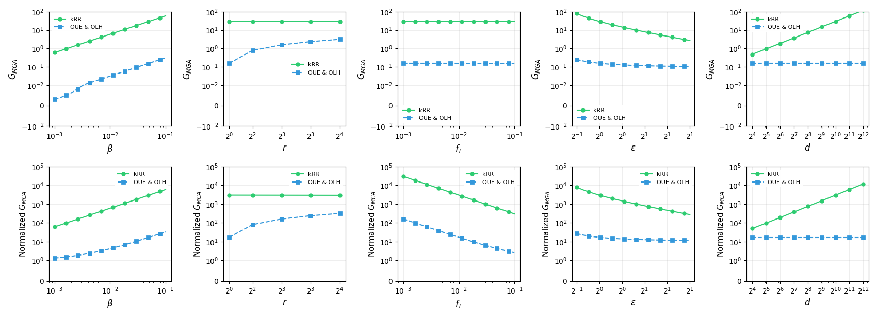
MGA Comparison
Notes:
Beta: Attack gain increases as the number of fake users increases. D: kRR performs worst when the domain size increases.
OLH and OUE performs poor with increasing number of target items => Future Direction

Slide 25
Conclusion

Slide 26
Summary and Open Questions
Different Frequency Estimation Protocols under LDP
Attacks on Estimators
  kRR performs poorly when the domain size increases
  OUE, OLH perform poorly when the target items increases
Open Question:
  Large domain, Large target items
  How to handle complex data types
  Utility – Privacy trade-offs

Slide 27
Thank You

